Slide 1
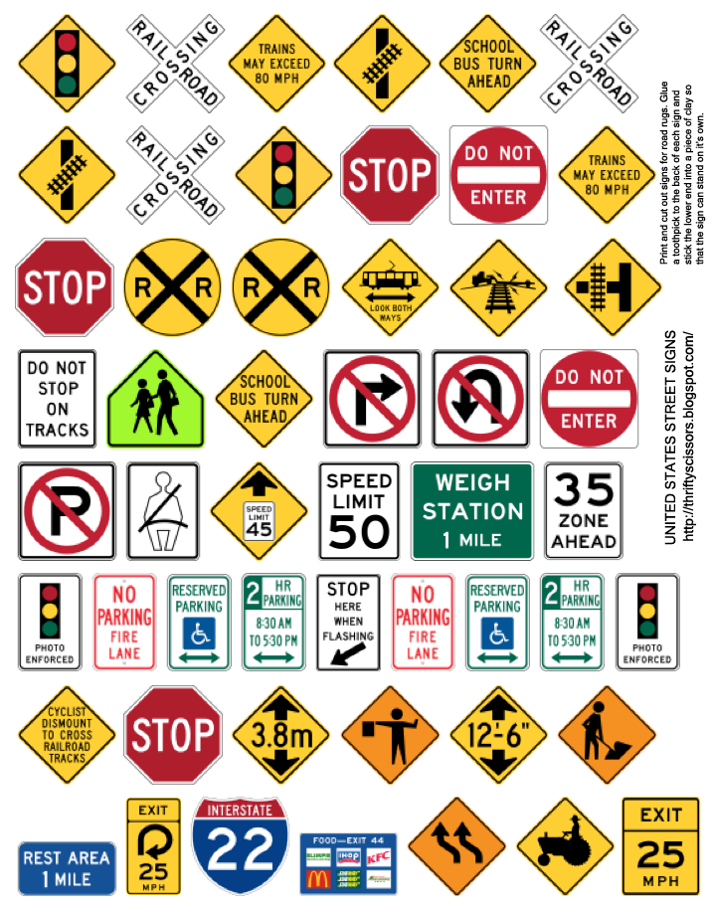
Road signs in the United States Classification

Slide 2
Contents
Background and Scope of work
Dataset
EDA
Convolutional Neural Network (CNN)
Test model with real world images
Next steps

Slide 3
Background and Scope of work
Traffic signs provide critical information drivers, which in turn requires them to adjust their driving behavior to make sure they follow with whatever road regulation currently enforced. Autonomous vehicles must also recognize and understand traffic signs to follow abide by road legislation.
I will build a convolutional neural network to classify traffic signs
Notes:
Consider talking about:
Anderson Committee
Worboys Committee
Guildford Rules

Slide 4
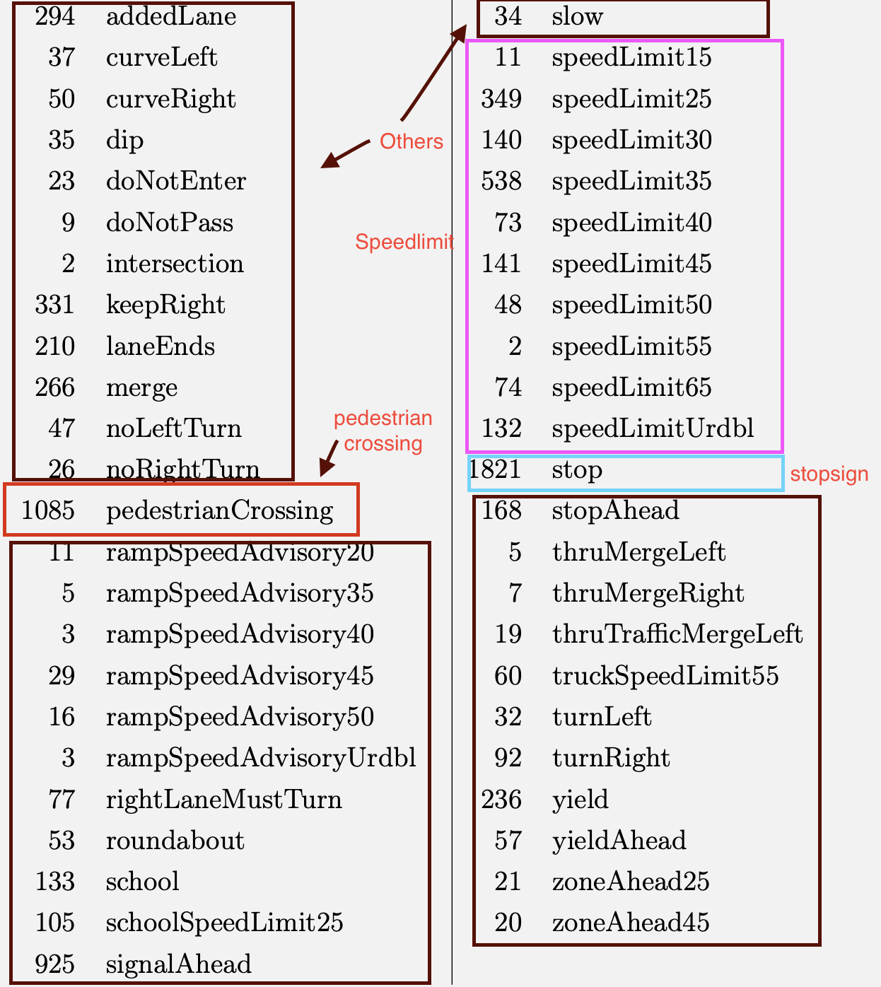
Dataset
Download from Laboratory for Intelligent & Safe Automobiles (LISA)
7840 rgb images-divided into 4 classes
Sign sizes from 6x6 to 168x168 pixels.
Notes:
Consider talking about:
Shape
Units of measurement
Colours
Typefaces
Language
Retroreflection

Slide 5
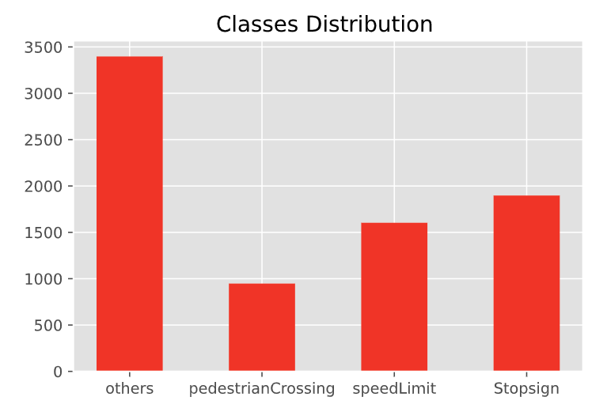
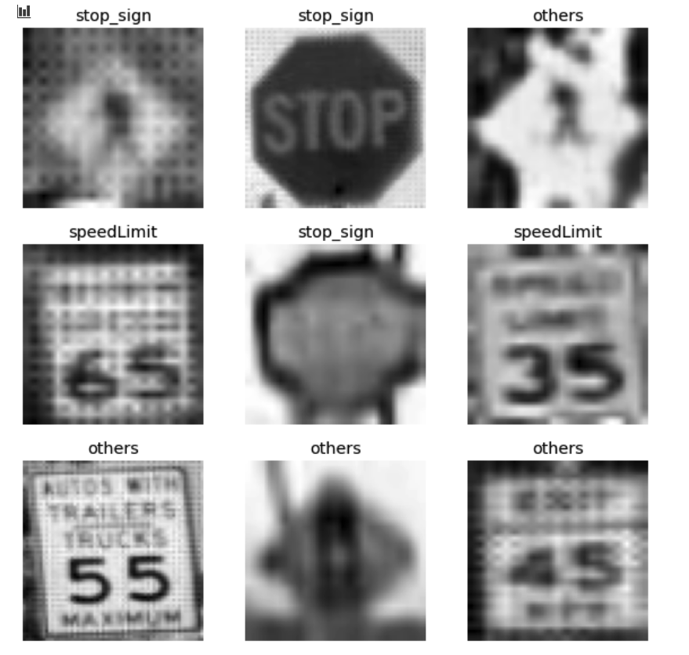
EDA
Notes:
Consider talking about:
Shape
Units of measurement
Colours
Typefaces
Language
Retroreflection

Slide 6
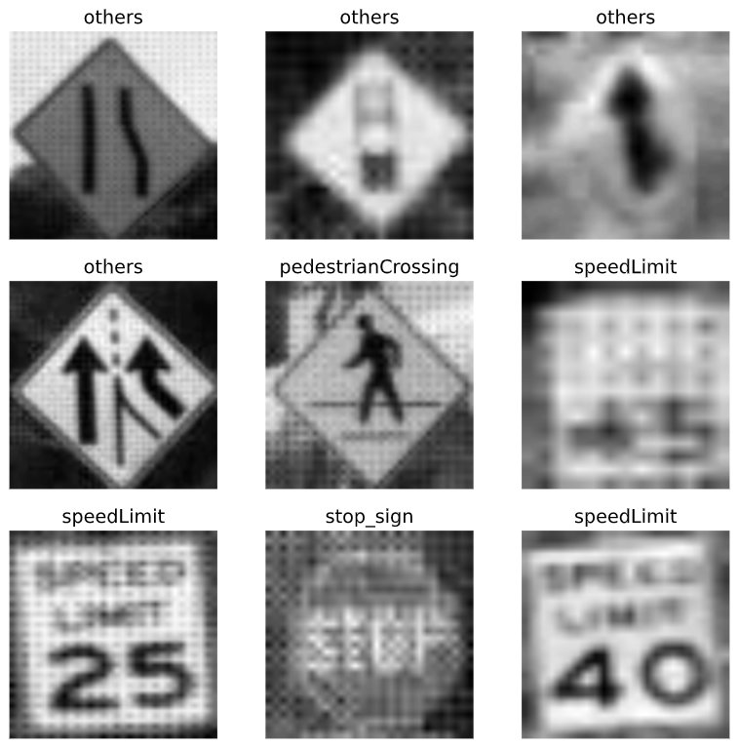
Create training data set
Rescale images to 32 x 32 x 1 (grayscale)
Split dataset into 80/20 train-validatation
Batch size = 32
Notes:
Consider talking about:
Shape
Units of measurement
Colours
Typefaces
Language
Retroreflection

Slide 7
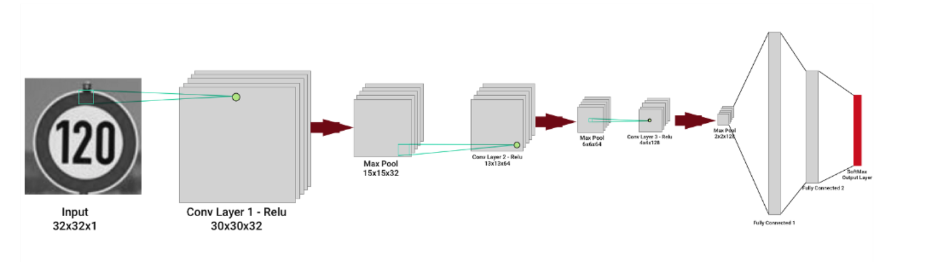
Build convolution neural network CNN
-Normalize dataset before train model
- CNN-3 layers
architecture proposed is inspired from Yann Le Cun’s paper
Notes:
Consider talking about:
Warning signs
Regulatory signs
Speed Limit Signs
Low Bridge Signs
Level crossing Signs
Bus and cycle signs
Pedestrian zone signs
Loading bays and Parking signs
Motorway signs
Directional road signs

Slide 8
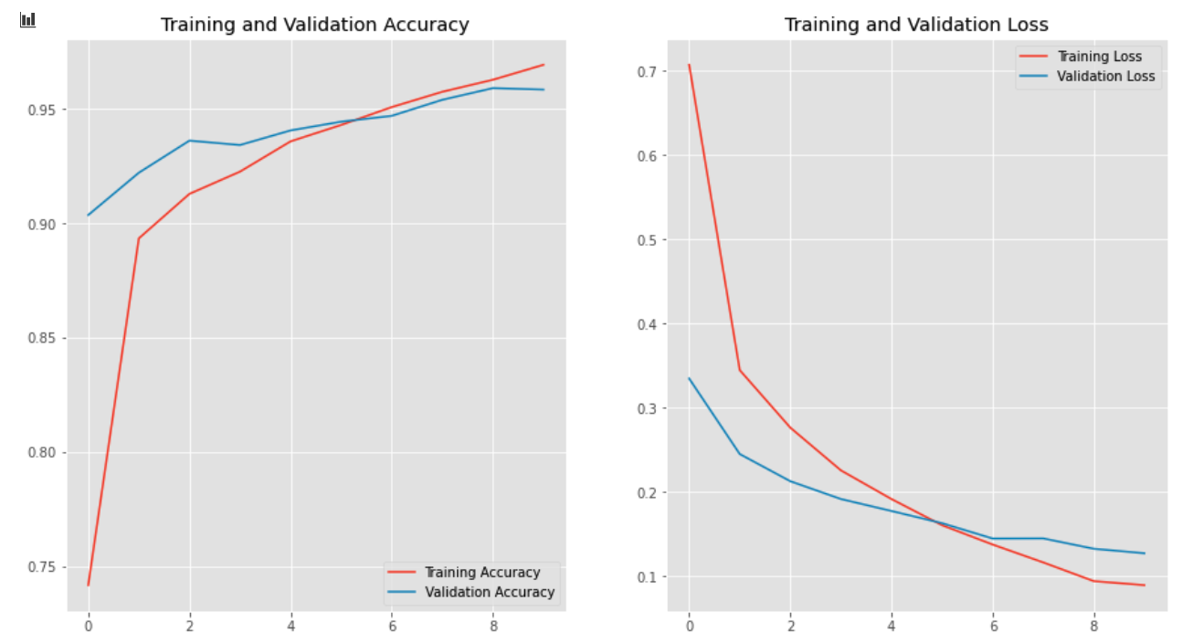
Notes:
Consider talking about:
Northern Ireland
Crown Dependencies
Overseas territories

Slide 9
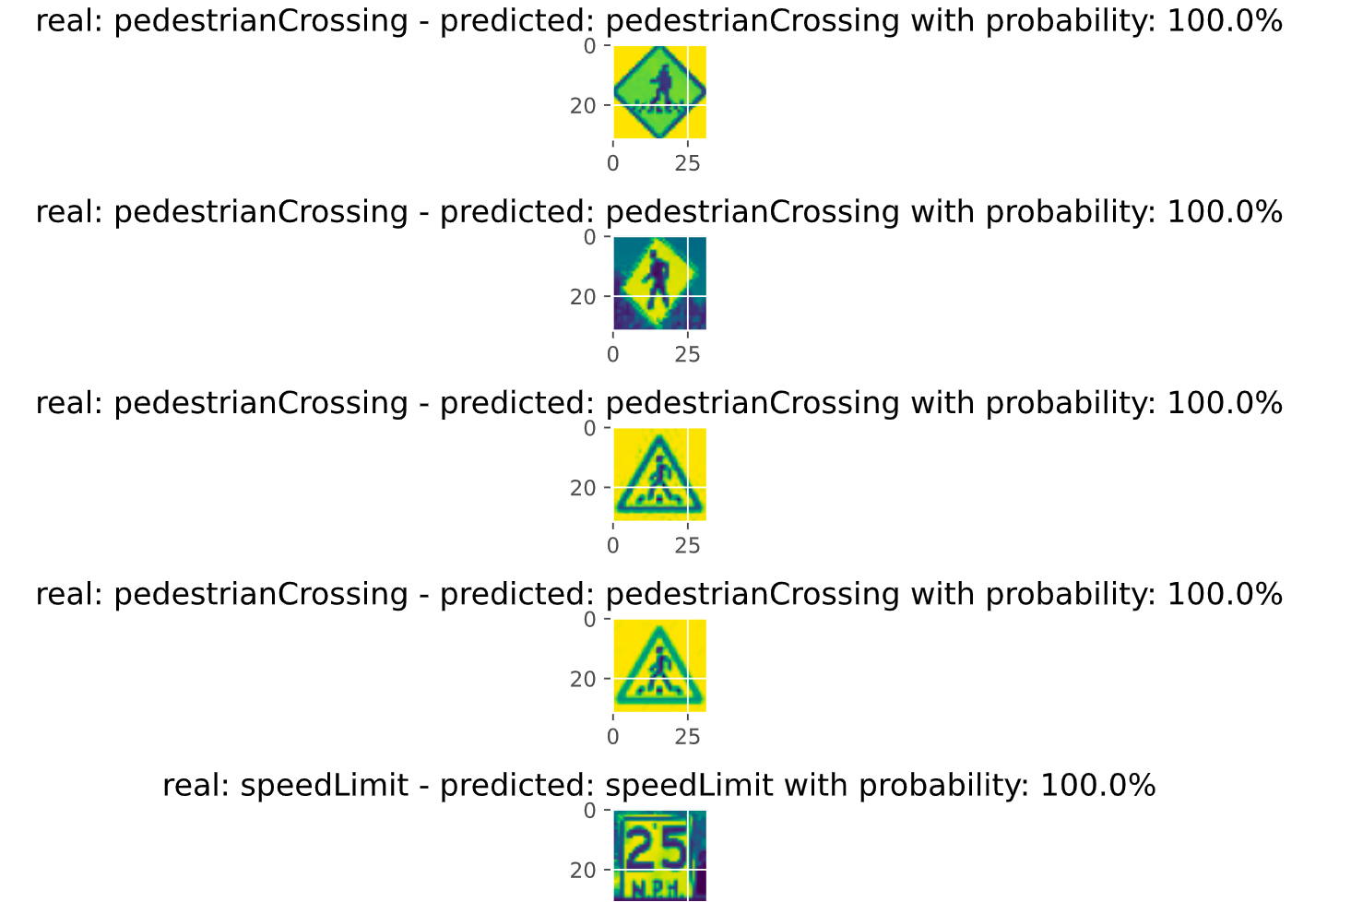
Test model with real world images
80 pre-cropped images :somes are taken by personal phone , others are downloaded from google

Slide 10
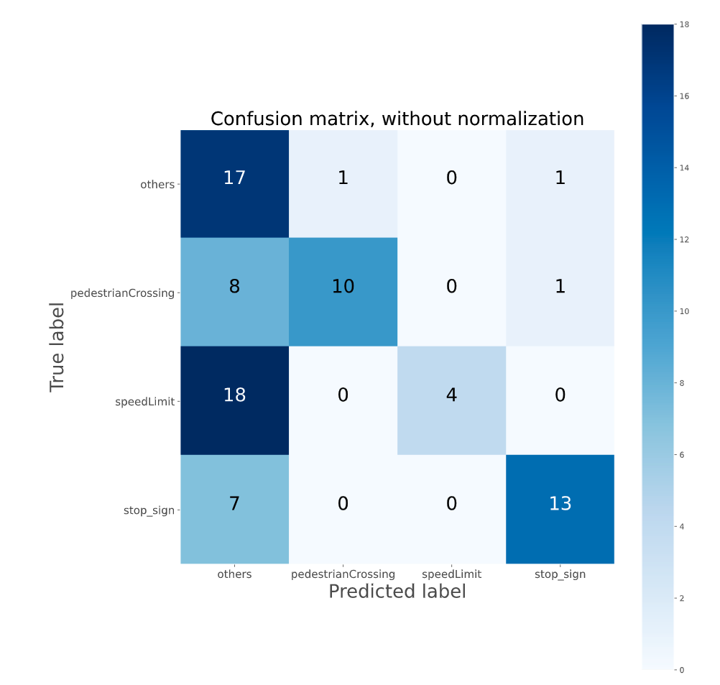
Test model with real world images
Test accuracy: 55%
Pre-cropped images :somes are taken by personal phone , others are downloaded from google

Slide 11
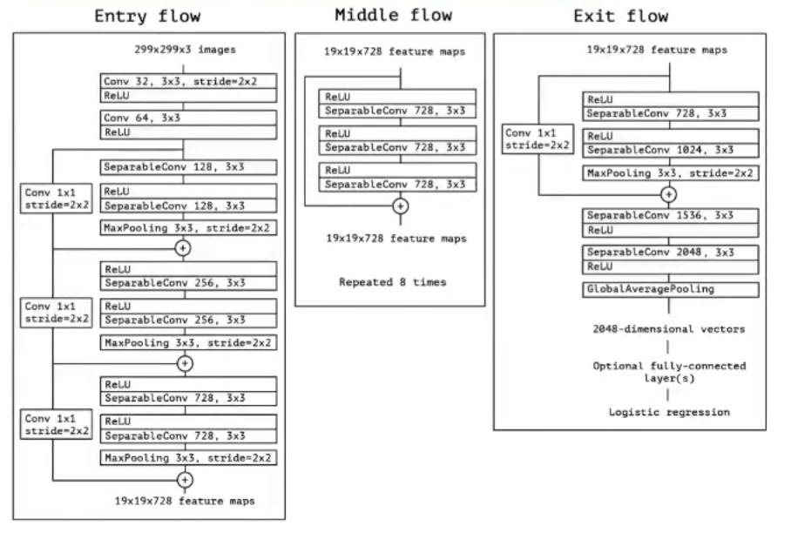
Transfer learning
-Import base Xception model from Keras without last layer
-Modify the last layer:
+Adding GlobalAveragePooling2D
+Modifying dense layer to 2048
+change activation to 'relu'
+Adding dropout rate .5
+change number of classes to 4
-Retrain dataset with different image size (299,299,3) and in rgb , with 5 epochs

Slide 12
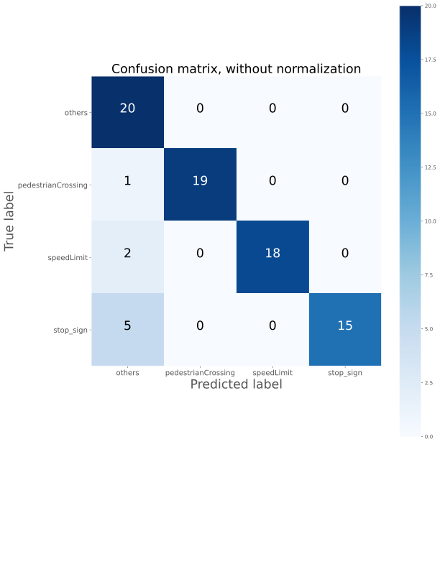
Transfer learning
Test accuracy: 90%
Stop_sign precision : 100% compare
to 86% in previous model

Slide 13
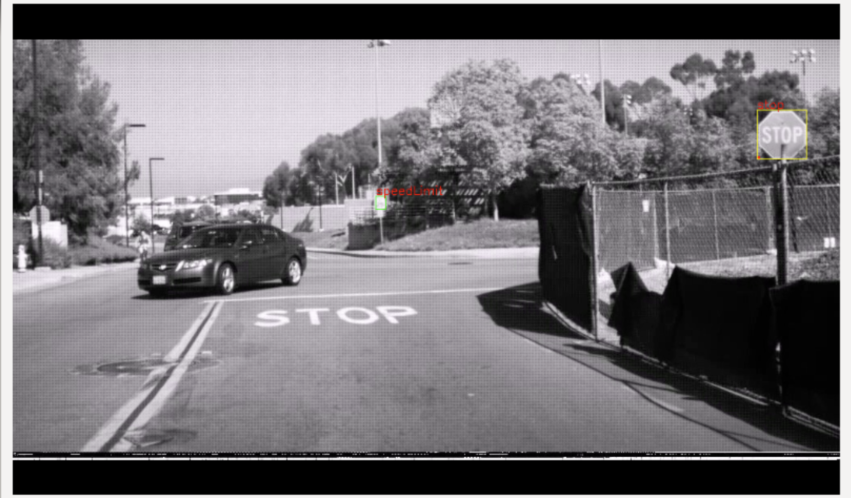
Next steps:
- Adding more images for each class
-Classify more classes
-Build traffic sign detection model

